Slide 1
Practical verification with CodeContracts
Francesco Logozzo
Joint work with M. Fahndrich and M. Barnett
Microsoft Research

Slide 2
Demo!!!!!

Slide 3
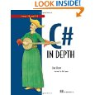

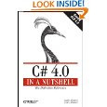
CodeContracts Impact
API in .NET 4.0
Externally available ~4 years
>100,000 downloads, very active forum
3 book chapters on CodeContracts
Many dozens of blog articles
Active forum
Internal and external adoption
Publications, talks, lectures
POPL, ECOOP, OOPSLA, VMCAI, APLAS, SAS, SAC, FoVeOOS, VSTTE …

Slide 4

Verification 101

Slide 5
Program verification
“The program does not go wrong”
What does it means?
It does not crash
Division by zero
Dereference of null (or 0 or nil)
No exception is thrown
…
It meets its specification
Specification???
What’s that?

Slide 6
Specification
Informally: “What the program should do”
“It should sort all the elements of the array”
Computers do not like English
(or Italian for what it matters ;-)
Which formal language?
How close to the computer?
How close to the human?
How close to the programmer?
How close to the verification tool?

Slide 7
A plethora of specification lang.
Implementation
Temporal Logic?
Z (B) notation?
UML?
TLA+ ?
Abstract state machines (ASM)?
JML? SparkAda? Code Contracts?
SAL?
…
Many many
...

Slide 8
Potato
Specification
The program behavior is included in the behaviors admissible from the specification:
Program is correct ☺
Program

Slide 9
Potato
Specification
The program behavior is not included in the behaviors admissible from the specification:
Program is incorrect ☹
(Some behavior may not meet the specification)
Program

Slide 10
How do we check potatos?
The problem is undecidable
Need to perform abstraction
In the concrete:
Is the program correct? Yes/No
In the abstract:
Is the program correct? Yes/No/I do not know
Which abstraction?
Upper-approximate the program semantics
Under-approximate the specification semantics

Slide 11
Potato (when lucky)
n
Add behaviors
Specification
Program
Remove specification
The over-approximation of the program behavior is included in the under-approximation of the admissible specification:
Program is correct! ☺

Slide 12
Potato (when unlucky)
n
Add behaviors
In this case, too many!
Specification
Program
Remove specification
The over-approximation of the program behavior is not included in the under-approximation of the admissible specification:
Program may be correct or it may not ☹

Slide 13
To sum up…
Specification
How do we specify the intent?
We should not over-specify
Verification
How do we check the program is doing the right thing?
Runtime (testing)
Static time (verification)

Slide 14
Specification with Contracts

Slide 15
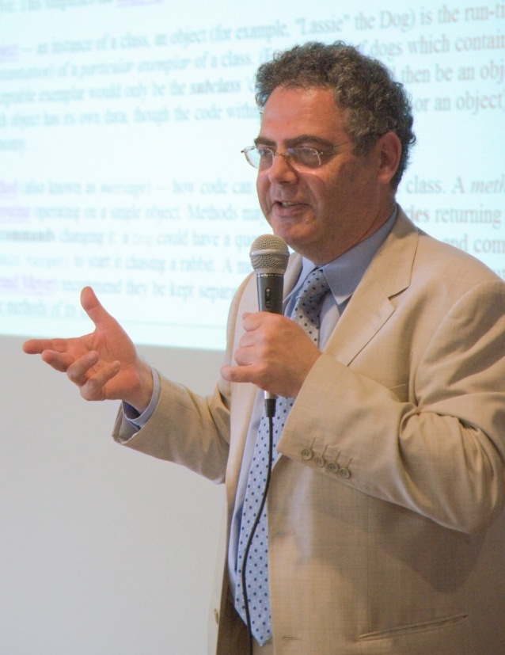
Contracts?
Each program module specifies
What it expects from its users
Precondition
What it ensures to its users
Postcondition
What holds in a stable state
Object invariants

Slide 16
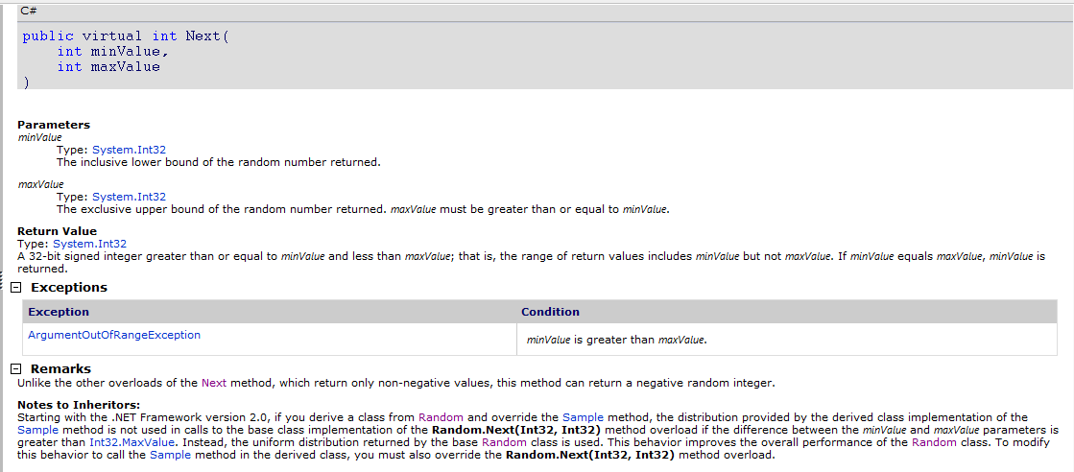
Contracts: What for?
Precondition
Postcondition

Slide 17
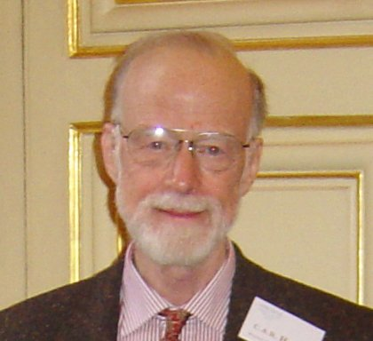
Contracts: What for?
Amplify runtime checking (debugging)
More assertions in the code
More stable the code
Assertions can be disabled
in release builds
Enable modular static analysis
Improved precision
Analysis should not assume worst case
More scalability
A little bit as a type-checker (but more refined!)

Slide 18
But we already have assertions!
All languages have an assert
assert(exp) macro in C/C++
assert exp keyword in Java
Debug.Assert(exp) static method in .NET
Assert is not visible from the caller!
static public int GCD(int x, int y)
{
Debug.Assert(x > 0);
Debug.Assert(y > 0);
}

Slide 19
Exceptions
Use exceptions for parameter validation:
At library surface
To protect from unwanted values
To early detect API misuses
Again, not visible to callers
static public int GCD(int x, int y)
{
if (x < 0)
throw new ArgumentException("Error");
… }

Slide 20
But we have Debug.Assert!
Cannot (easily) specify a postcondition
static public int GCD(int x, int y)
{
Debug.Assert(x > 0);
Debug.Assert(y > 0);
while (true)
if (x < y) { y %= x; if (y == 0) return x; }
else { x %= y; if (x == 0) return y; }
}
Debug.Assert(Result > 0) ?

Slide 21
Assert & OOP : ☹
Inheritance
Precondition: Should be weaker
Postcondition: Should be stronger
How do I enforce it?
Object invariants
Valid in steady states
Ex: this.x != null
Should I add it at every method??
Interfaces, abstract methods
Where I put my assert?

Slide 22
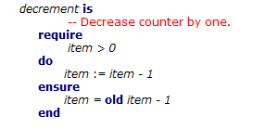
Contracts yesterday
First class citizens in the language
Provide syntax to express contracts
Examples: Eiffel, D, Spec# …
Why not everyone was using it?
New language (start from scratch, or almost)
New compiler (do you trust it?)

Slide 23
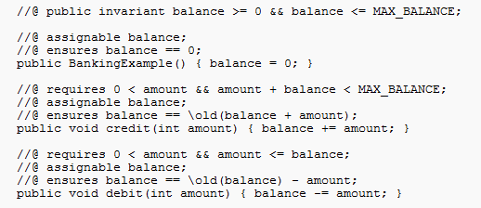
Contracts yesterday
Inside comments or as code annotation
Ex. JML, SparkAda, Eclipse for non-null …
Problems?
Persistence?
Need for serialization, parsing…
Separate type checking, name resolution…

Slide 24
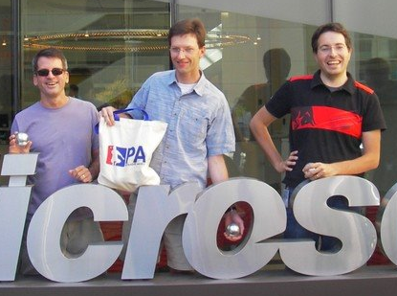
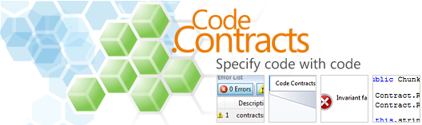
Code contracts

Slide 25
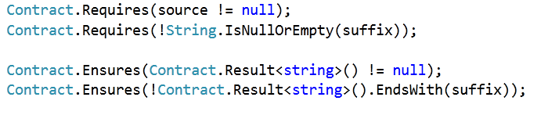

Code Contracts
Idea: Use the IL as contract representation
Use static methods to a contract library
Language agnostic: same for C#, VB, F# …

Slide 26
What are they?
Plain code for contracts
Static methods to a contract library
Language agnostic: same for C#, VB, F# …
Standard from .NET 4.0
No need for a new compiler/language
Precondition: Contract.Requires(...)
Postcondition: Contract.Ensures(…)
Invariant: Contract.Invariant(…)

Slide 27
Preconditions
Contract.Requires(exp)
int foo(String s, int y)
{
Contract.Requires(s != null);
Contract.Requires(y > 0);
// ...
}
C# expressions

Slide 28
Preconditions
Which is the underlying language specification?
Your programming language!!!
Public Function foo(ByVal s As String, ByVal y As Integer)
As Integer
Contract.Requires(s IsNot Nothing)
Contract.Requires(y > 0)
‘ …
End Function
VB expressions
Int32 __gc* foo(String __gc* s, Int32 __gc* y)
{
Contract::Requires(s != 0);
Contract::Requires(y > 0);
C++ expressions

Slide 29
Postconditions
Contract.Ensures(exp)
Class Field
{
int x;
int Set(int y)
{
Contract.Ensures(this.x == y);
this.x = y;
}
}

Slide 30
Result value?
In C#/VB/… no name for the returned value
Use a dummy method
public int Fact(int x)
{
Contract.Ensures(Contract.Result<int>() >= 0); …
}

Slide 31
Question
Why <int> ?
Why <bool[]> ?
public int Fact(int x)
{
Contract.Ensures(Contract.Result<int>() >= 0); …
}
public bool[] ArrayFactory(int x)
{
Contract.Ensures(Contract.Result<bool[]>() != null); return new bool[x];
}
T Contract.Result<T>()

Slide 32
Old value?
No name for the old value
Class Account
{
int balance;
int Add(int k)
{
Contract.Ensures(this.balance == Contract.Old(this.balance) + k);
this.balance += k;
}
}
T Contract.Old<T>(T value)

Slide 33
Quantifiers
Limited form:
Contract.ForAll(0, A.Length, i => A[i] > 0);
Contract.Exists(0, A.Length, i => A[i] > 0);
Exploit higher order functions

Slide 34
Class Invariant
Class Account
{
int balance;
[ContractInvariantMethod]
protected void ObjectInvariant()
{
Contract.Invariant(balance >= 0);
}
}

Slide 35
Interfaces
[ContractClass(typeof(WithdrawContracts))]
interface IWithdraw
{
long Balance { get; }
void Withdraw(long money);
}
[ContractClassFor(typeof(IWithdraw))]
public class WithdrawContracts : IWithdraw {
public long Balance { get { Contract.Ensures(Contract.Result<long>() >= 0); return -111; } }
public void Withdraw(long money) {
Contract.Requires(money < this.Balance);}}

Slide 36
Other
Abstract classes
Similar to interfaces
Out/ref parameters
Use dummy method
Legacy code: “if !exp throw exception”
Use Contract.EndContract()

Slide 37
Advantages
Produced by all the compilers
Free:
Types
Intellisense
Name resolution…
Cross language
Precise semantics
Uniform format understood by our tools

Slide 38
Runtime verification (aka Testing)

Slide 39
Potato & testing
Specification
One execution is outside the specification
The program is incorrect!

Slide 40
Potato & testing
Specification
A sample of the program behavior is included in the behaviors admissible from the specification
Is the program correct?

Slide 41
Testing
Prove the existence of specification violations
i.e. the existence of bugs
If a test fails, then there is a bug
Cannot verify the program
i.e. the existence of no bug!
Can try only finitely main inputs
100% code coverage do not imply 100% data coverage
Yet, very useful!!!

Slide 42
Runtime checking of contracts
C# compiler does not know about contracts
Achieved via binary rewriting
Handle old, result …
Inherit contracts
Stick contracts to interface implementations

Slide 43
Binary rewriting
public virtual int Add(object value){
Contract.Requires( value != null );
Contract.Ensures( Count == Contract.OldValue(Count) + 1 );
Contract.Ensures( Contract.Result<int>() == Contract.OldValue(Count) );
if (_size == _items.Length) EnsureCapacity(_size+1);
_items[_size] = value;
return _size++;
}
Executable Runtime
Contract Checking
.method public hidebysig newslot virtual instance int32 Add(object 'value') cil managed
{
.locals init (int32 'Contract.Old(Count)',
int32 'Contract.Result<int>()')
ldarg.0
call instance int32 TabDemo.BaseList::get_Count()
stloc.3
ldarg.1
ldnull
ceq
ldc.i4.0
ceq
ldstr "value != null"
call void __RewriterMethods::RewriterRequires$PST06000009(bool, string)
ldarg.0
ldfld int32 TabDemo.BaseList::count
ldarg.0
ldfld object[] TabDemo.BaseList::items
ldlen
conv.i4
ceq
ldc.i4.0
ceq
stloc.1
ldloc.1
brtrue IL_004d
nop
ldarg.0
ldarg.0
ldfld int32 TabDemo.BaseList::count
ldc.i4.1
add
call instance void TabDemo.BaseList::EnsureCapacity(int32)
nop
nop
ldarg.0
ldfld object[] TabDemo.BaseList::items
ldarg.0
ldfld int32 TabDemo.BaseList::count
ldarg.1
stelem.ref
ldarg.0
dup
ldfld int32 TabDemo.BaseList::count
dup
stloc.2
ldc.i4.1
add
stfld int32 TabDemo.BaseList::count
ldloc.2
stloc.0
br IL_0072
ldloc.0
stloc.s 'Contract.Result<int>()'
br IL_007a
ldarg.0
call instance int32 TabDemo.BaseList::get_Count()
ldloc.3
ldc.i4.1
add
ceq
ldstr "Count == Contract.Old(Count) + 1"
call void __RewriterMethods::RewriterEnsures$PST0600000B(bool, string)
ldloc.s 'Contract.Result<int>()'
ldloc.s V_4
ceq
ldstr "Contract.Result<int>() == Contract.Old(Count)"
call void __RewriterMethods::RewriterEnsures$PST0600000B(bool, string)
ldloc.s 'Contract.Result<int>()'
ret
}
csc/vbc/…
Release Compile
/d:CONTRACTS_FULL
.method public hidebysig newslot virtual instance int32 Add(object 'value') cil managed
{
ldarg.1
ldnull
ceq
ldc.i4.0
ceq
call void [Microsoft.Contracts]Microsoft.Contracts.Contract::Requires(bool)
ldarg.0
call instance int32 TabDemo.BaseList::get_Count()
ldarg.0
call instance int32 TabDemo.BaseList::get_Count()
call !!0 [Microsoft.Contracts]Microsoft.Contracts.Contract::Old<int32>(!!0)
ldc.i4.1
add
ceq
call void [Microsoft.Contracts]Microsoft.Contracts.Contract::Ensures(bool)
call !!0 [Microsoft.Contracts]Microsoft.Contracts.Contract::Result<int32>()
ldarg.0
call instance int32 TabDemo.BaseList::get_Count()
call !!0 [Microsoft.Contracts]Microsoft.Contracts.Contract::Old<int32>(!!0)
ceq
call void [Microsoft.Contracts]Microsoft.Contracts.Contract::Ensures(bool)
ldarg.0
ldfld int32 TabDemo.BaseList::count
ldarg.0
ldfld object[] TabDemo.BaseList::items
ldlen
conv.i4
ceq
ldc.i4.0
ceq
stloc.1
ldloc.1
brtrue.s IL_0069
ldarg.0
ldarg.0
ldfld int32 TabDemo.BaseList::count
ldc.i4.1
add
call instance void TabDemo.BaseList::EnsureCapacity(int32)
ldarg.0
ldfld object[] TabDemo.BaseList::items
ldarg.0
ldfld int32 TabDemo.BaseList::count
ldarg.1
stelem.ref
ldarg.0
dup
ldfld int32 TabDemo.BaseList::count
dup
stloc.2
ldc.i4.1
add
stfld int32 TabDemo.BaseList::count
ldloc.2
stloc.0
br.s IL_008b
ldloc.0
ret
} // end of method BaseList::Add
csc/vbc/…
ccrewrite
.method public hidebysig newslot virtual instance int32 Add(object 'value') cil managed
{
ldarg.0
ldfld int32 TabDemo.BaseList::count
ldarg.0
ldfld object[] TabDemo.BaseList::items
ldlen
conv.i4
ceq
ldc.i4.0
ceq
stloc.1
ldloc.1
brtrue.s IL_0029
ldarg.0
ldarg.0
ldfld int32 TabDemo.BaseList::count
ldc.i4.1
add
call instance void TabDemo.BaseList::EnsureCapacity(int32)
ldarg.0
ldfld object[] TabDemo.BaseList::items
ldarg.0
ldfld int32 TabDemo.BaseList::count
ldarg.1
stelem.ref
ldarg.0
dup
ldfld int32 TabDemo.BaseList::count
dup
stloc.2
ldc.i4.1
add
stfld int32 TabDemo.BaseList::count
ldloc.2
stloc.0
br.s IL_004b
ldloc.0
ret
}

Slide 44
Static verification

Slide 45
Static verification with potatos
n
Add behaviors
Specification
Program
Remove specification
The over-approximation of the program behavior is included in the under-approximation of the admissible specification:
Program is correct! ☺

Slide 46
Static verification
Any static verification method is incomplete
Verification is not decidable
public static bool NotDecidable()
{
if (SolvableDiophantineEquation)
return 1;
else
Contract.Assert(false);
}
Not decidable (Hilbert’s 10th problem)

Slide 47
Verification techniques
Many, many out there…
Model Checking
Theorem proving
Automatic
SMT solvers, resolution based, …
Semi-automatic
2nd order
All those instances of Abstract interpretation!

Slide 48
Abstract interpretation

Slide 49


Abstract Interpretation
Theory of approximations
Semantics are order according to the precision
The more the precise the semantics
The more the properties captured
A static analysis is a semantics
Precise enough to capture the properties of interest
Rough enough to be computable

Slide 50
Basic Concepts of abstract interpretation
Concrete domain
A mathematical structure describing the most precise information on the program
Usually the program semantics
Traces, operational, denotational …
Abstract domain
A mathematical structure describing the property of interests
Ex.: range of a variable

Slide 51
Example: Rule of signs
Abstract semantics is over signs
a⟦ k ⟧ρ | = | sign(k)
a⟦ x ⟧ρ | = | ρ( x )
a⟦e1 + e2 ⟧ρ | = | a⟦ e1 ⟧ρ + a⟦ e2 ⟧ρ
a⟦e1 * e2 ⟧ρ | = | a⟦ e1 ⟧ρ * a⟦ e2 ⟧ρ
+ | ⊥ | neg | zero | pos | ⊤
⊥ | ⊥ | ⊥ | ⊥ | ⊥ | ⊥
neg | ⊥ | neg | neg | ⊤ | ⊤
zero | ⊥ | neg | zero | pos | ⊤
pos | ⊥ | ⊤ | pos | Pos | ⊤
⊤ | ⊥ | ⊤ | ⊤ | ⊤ | ⊤

Slide 52
Example: Rule of signs
(12345565 * 13456) + (-9873 * -1344678)
Sign of the result?
Do the computation: 179 397 928 534
Then take the sign : pos
Do the abstract computation:
(pos * pos) + (neg * neg)
= pos + pos
= pos

Slide 53

CodeContracts Static checker aka Clousot

Slide 54
Algorithm: High level
Construct an approximation of the Control Flow Graph
Analyze the methods in bottom-up order
Extract the proof obligations
What should I prove?
Run the analyses
Discover facts on the program
Use the facts to prove the proof obligations
If not, do something else…
Infer Pre, Post, Obj. Invariants and codefixes

Slide 55
Proof obligations
Two kinds: Implicit and explicit
Implicit
NonNull checking
Bounds checking
Arithmetic: Divisions by zero, overflows,
…
Explicit
Assertions
When calling a method, its precondition
When returning from a method, its postcondition

Slide 56
NonNull dereference
The string s should not be null
Otherwise, exception at run time
Generate the proof obligation: s != null
public bool IsCiao(string s)
{
return s.Contains("ciao!");
}

Slide 57
Array bounds
public int[] RandomArray(int len)
{
var random = new Random(len);
var arr = new int[len];
for (var i=0; i < len; i++)
{
arr[i] = random.Next();
}
return arr;
}
len >= 0
i < arr.Length
i >= 0

Slide 58
Overflows
public int Abs(int x)
{
if (x < 0)
return -x;
return x;
}
public int Div(int x, int y)
{
return x / y;
}
y != 0
x != MinValue
x != MinValue || y != -1

Slide 59
Explicit obligation: Assertions
public string Concat(string p, string q)
{
Contract.Requires(p != null);
Contract.Requires(q != null);
var concat = p + q;
Contract.Assert(concat != null);
Contract.Assert(concat.Length > 0);
return concat;
}
concat != null
concat.Length > 0

Slide 60
Preconditions
public string Concat(string p, string q)
{
Contract.Requires(p != null);
Contract.Requires(q != null);
// …
}
public string MyConcat()
{
return Concat("Ciao", null);
}
Concat “believes”
(assumes)
those preconditions
“Ciao” != null
null != null

Slide 61
Postconditions
Note: the program is wrong, why???
public double Abs(double x)
{
Contract.Ensures(
Contract.Result<double>() >= 0);
if (x < 0)
return -x;
return x;
}
public double Sqrt(double z)
{
return Math.Sqrt(Abs(z));
}
-x >= 0
x >= 0
Sqrt “believes”
(assumes)
Abs(z) >= 0

Slide 62
Algorithm: High level
Construct an approximation of the Control Flow Graph
Analyze the methods in bottom-up order
Extract the proof obligations
What should I prove?
Run the analyses
Discover facts on the program
Use the facts to prove the proof obligations
If not, do something else…
Infer Pre, Post, Obj. Invariants and codefixes

Slide 63
Inferred facts
Heap structure
Null/Not-Null
Numerical values
Ranges, relations, floating points …
Enum values
Array/Collection contents
…

Slide 64
Example
public string TrimSuffix(string s, string suffix)
{
Contract.Requires(s != null);
Contract.Requires(suffix != null);
string res = s;
while (res.EndsWith(suffix))
{
int len = res.Length - suffix.Length;
res = res.Substring(0, len);
}
Contract.Assert(res != null);
return res;
}

Slide 65
NonNull analysis
Associate to each variable an element of
⊤
Null
NotNull
⊥

Slide 66
With proof obligations explicit
public string TrimSuffixWPO(string s, string suffix)
{
Contract.Requires(s != null);
Contract.Requires(suffix != null);
string res = s;
Contract.Assert(res != null);
while (res.EndsWith(suffix))
{
Contract.Assert(res != null);
Contract.Assert(suffix != null);
int len = res.Length - suffix.Length;
Contract.Assert(res != null);
res = res.Substring(0, len);
Contract.Assume(res != null); // Postcondition of res
}
Contract.Assert(res != null);
return res;
}

Slide 67
Checking
public string TrimSuffixWPO(string s, string suffix)
{
Contract.Requires(s != null);
Contract.Requires(suffix != null);
string res = s;
Contract.Assert(res != null);
while (res.EndsWith(suffix))
{
Contract.Assert(res != null);
Contract.Asert(suffix != null);
int len = res.Length - suffix.Length;
Contract.Assert(res != null);
res = res.Substring(0, len);
Contract.Assume(res != null); // Postcondition of res
}
Contract.Assert(res != null);
return res;
}
s, suffix: NotNull, res : Null
s, suffix, res: NotNull
s, suffix, res: NotNull
s, suffix : NotNull, res: ⊤
s, suffix, res: NotNull
Ok!

Slide 68
What we did?
We over-approximated the semantics
We kept the concrete specification
Specification
Program

Slide 69
static public int GCD(int x, int y)
{
Contract.Requires(x > 0);
Contract.Requires(y > 0);
Contract.Ensures(Contract.Result<int>() > 0);
while (true)
{
if (x < y)
{
y %= x;
if (y == 0)
return x;
}
else
{
x %= y;
if (x == 0)
return y;
}
}
}
We need numerical reasoning
We need to infer loop invariants

Slide 70
Numerical Analysis
0 ≤ index < array.Length?
Intervals
O(n)
a ≤ x ≤ b
No ☹
Pentagons
O(n)
a≤ x ≤ b & x <y
Yes ☺
Octagons
O(n³)
± x ± y ≤ a
Yes ☺
Polyhedra
O(2^{n})
Σ a_{i}x_{i} ≤ b
Yes ☺

Slide 71
Intervals
Approximate each variable with a range
[a, b] where a, b ∈ Z ∪ { +∞, -∞ }
More complex in reality because of
Overflows
Different Int types (16, 32, 64 bits, signed/unsigned)
Idea: Replace a value, a set of values with an interval

Slide 72
static public int GCD(int x, int y)
{
Contract.Requires(x > 0);
Contract.Requires(y > 0);
Contract.Ensures(Contract.Result<int>() > 0);
while (true)
{
if (x < y)
{
y %= x;
if (y == 0)
return x;
}
else
{
x %= y;
if (x == 0)
return y;
}
}
}
x :[1,+∞] y :[1,+∞]
x :[1,+∞] y :[1,+∞]
Loop invariant!
x :[1,+∞], y:[2, +∞]
x :[1,+∞], y:[0, +∞]
x :[1,+∞], y:[1, +∞]
x :[1,+∞], y:[1, +∞]
Ok!
x :[0,+∞], y:[1, +∞]
x :[1,+∞], y:[1, +∞]

Slide 73
Bounds checking example
public void AllToZero(int[] a)
{
for (int i = 0; i < a.Length; i++)
{
Contract.Assert(i >= 0);
Contract.Assert(i < a.Length);
a[i] = 0;
}
}
a.Length :[0. +∞] i :[0,+∞]
Not Ok!

Slide 74
What are we missing?
Intervals keep only numerical information
No symbolic information
Ex. i < a.Length
No relations
Intervals are an example of a non-relational domain
Non-null is non-relational too

Slide 75


Pentagons
Capture properties in the form of
x, y variables
a, b constants
Elements are pairs of maps
(Var → Intv) x (Var → ℘(Var))
Information is propagated
“reduction”

Slide 76

Subpolyhedra
Needed for more complex examples
∑a_{i} x_{i} ≤ k ⇔ ∑a_{i} x_{i} = β ⋀ β ≤ k
Introduce a slack variable β
Reduced product of
Intervals
Scalable, fast…
Linear Equalities
Precise join, fast …
Challenge: Have a precise Join

Slide 77
Inferring array contents…
Challenge 1:
Effective handling of disjunction
public void Init(int N)
{
Contract.Requires(N > 0);
int[] a = new int[N];
int i = 0;
while (i < N)
{
a[i] = 222;
i = i + 1;
}
Contract.Assert(∀ k ∈ [0, N). a[k] == 222);
}
If i == 0 then
a not initialized
else if i > 0
a[0] == … a[i] == 222
else
impossible
Challenge 2:
No overapproximation (can be unsound)
(no hole, all the elements are initialized)

Slide 78
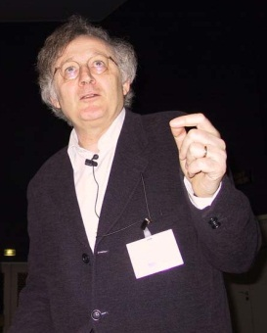

Our idea
Precise and very very fast!
Basis: Array segments
Segment bounds
Disjunction
Uniform content abstraction
0
[222, 222]
i, k
?
[0, 0]
N
0 ≤ i, 0 ≤ k
i == k
i < N, k < N

Slide 79
Example
Contract.Requires(N > 0);
int[] a = new int[N];
0
0
N
int i = 0;
0,i
0
N
0
222
1,i
0
N
?
assume i ≥ N
assume i < N
i -> _
j -> i
N -> N
0,i
0
N
a[i] = 222;
0,i
222
1,i+1
0
N
?
j = i+1;
0,i
222
1,i+1,j
0
N
?

Slide 80
Segment unification
0,i
0
N
0
222
1,i
0
N
?
0
⊥
i
?
0
N
0
222
1,i
0
N
?
0
⊥
i
?
0
N
0
222
i
0
N
?
Join
Can be empty segments! (Disjunction)
0
222
i
?
0
N
?

Slide 81
Example
Contract.Requires(N > 0);
int[] a = new int[N];
int i = 0;
0
222
i
?
0
N
?
Remove doubts
(i == N && N > 0)
assume i ≥ N
assume i < N
0
222
i
?
0
N
0
222
i, N
a[i] = 222;
i -> _
j -> i
N -> N
And so on up to a fixpoint …
We visited all the elements in [0, N)
j = i+1;

Slide 82
Algorithm: High level
Construct an approximation of the Control Flow Graph
Analyze the methods in bottom-up order
Extract the proof obligations
What should I prove?
Run the analyses
Discover facts on the program
Use the facts to prove the proof obligations
If not, do something else…
Infer Pre, Post, Obj. Invariants and codefixes

Slide 83
Proving things
We inferred many facts on the program
We use those to prove assertions
Algorithm:
For each assertion a at program point p
For each set of facts F
Check if F(p) implies a:
True: It is always ok
False: It is always not ok
Bottom: The assertion is never reached
Top: We do not know

Slide 84
Why do we get Top?
The analysis is not precise enough
Abstract domain not precise
Widening loses too many constraints
Algorithmic properties
Implementation bug
Incompleteness
Some contract is missing
Precondition or Postcondition
Object-invariant
The assertion is sometimes wrong

Slide 85
Incremental analysis in Clousot
First analyze with “cheap” domains
If check != Top
Done!
If check == Top
Try a more precise domain
On the average great performance gains
Persist analysis options in different runs
Domain D1
Domain D2
Domain D3

Slide 86
Disjunctions
(So far) Join approximates disjunction
Compact representation
Sometimes not enough:
public string Simple2(bool b)
{
Contract.Ensures(
Contract.Result<string>() == null
|| Contract.Result<string>().Length > 0);
if (b)
return null;
else
return "Ciao!";
}
public int Simple(bool b)
{
int z;
if (b)
z = 12;
else
z = -12;
return 1 / z;
}

Slide 87
The solution in Clousot
Backward analysis
The failing assertion is pushed back to the program
public int Simple(bool b)
{
int z;
if (b)
z = 12;
else
z = -12;
return 1 / z;
}
z : [12, 12]
z != 0
z : [-12, -12]
z != 0
z :[- ∞,+∞]
z != 0

Slide 88
More complex example
public string Simple2(bool b)
{
Contract.Ensures(
Contract.Result<string>() == null
|| Contract.Result<string>().Length > 0);
if (b)
return null;
else
return "Ciao!";
}

Slide 89
Example with loop
public void NonNull()
{
string foo = null;
for (int i = 0; i < 5; i++)
{
foo += "foo";
}
Contract.Assert(foo != null);
}
foo: Null
foo != null
foo: T
foo: NotNull
foo != null
foo: T
foo != null

Slide 90
Contract Inference

Slide 91
Necessary preconditions

Slide 92
Example
Sufficient precondition: a != null
Too strong for the caller
No runtime errors when x < 0 and a == null
Clousot users complained about it
“wrong preconditions”
int Example1(int x, object[] a)
{
if (x >= 0)
{
return a.Length;
}
return -1;
}

Slide 93
Example
Sufficient precondition: false
It may fail, so eliminate all runs
Necessary precondition: 0 < a.Length
If a.Length == 0 it will always fail
Necessary precondition is weaker than the weakest precondition!!!
void Example2(object[] a)
{
Contract.Requires(a != null);
for (var i = 0; i <= a.Length; i++)
{
a[i] = F(a[i]);
if (NonDet())
return;
}
}

Slide 94
Program semantics
Program traces: T = G ∪ B ∪ I
G = good traces, terminating in a good state
B = bad traces, terminating in an assertion violation
Assertions:
Language-induced: division by zero, null pointers, buffer overrun …
User-supplied annotations: assertions, preconditions, postconditions, object invariants
I = infinite traces, non-termination
Notation: X(s) are the traces starting with s

Slide 95
Necessary and sufficient
In S ⟹ N we say that
S in a sufficient condition for N
N is a necessary condition for S
For a program P
A condition S is sufficient if its truth ensures that P is correct
A condition N is necessary if its falsehood ensures P is incorrect

Slide 96
Weakest (liberal) preconditions
Provide sufficient preconditions guaranteeing partial correctness:
wlp(P, true)(s₀) ≝ (B(s₀) = ∅)
Drawbacks of wlp for the automatic inference of preconditions:
With loops, there is no algorithm to compute wlp(P, true)
Solution in deductive verification: Use loop invariant
Inferred preconditions are sufficient but not the weakest anymore
Under-approximation of loops
Sufficient preconditions rule out good runs
Callers should satisfy a too strong condition

Slide 97
Example
int Sum(int[] xs)
{
Contract.Requires(xs != null);
int sum = 0;
for (var i = 0; i < xs.Length; i++)
sum += xs[i];
Contract.Assert(sum >=0);
return sum;
}
Overflows are not an error
Ex. Sum([-2147483639, 2147483638, -10]) = 19
In deductive verification, provide loop invariant
Which is the weakest precondition?
The method itself
Sufficient preconditions:
∀i ∈ [0, xs.Length], 0 ≤ xs[i] < MaxInt/xs.Length
or
xs.Length == 3 ∧ xs[0] + xs[1] == 0 ∧ xs[2] >= 0
or
….

Slide 98
Under-approximation of wlp
Formally, with loop invariants, we compute a sufficient condition S:
S(s₀) ⟹ wlp(P, true)(s₀)
Which is equivalent to
[I(s₀) = ∅] ⟹ [S(s₀) ⟹ G(s₀) ≠ ∅]
So that it may exists some initial state s such that
¬ S(s) ∧ G(s) ≠ ∅
i.e., s does not satisfy S, but it does not lead to a bad state

Slide 99
Consequences
Sufficient preconditions impose too large a burden to the caller
They just ensure the correctness of the callee
Not practical in a realistic setting
Users complained about “wrong” preconditions
“wrong preconditions” = sufficient preconditions

Slide 100
Strongest necessary preconditions
If the program terminates in a good state for s₀ then N(s₀) should hold:
[I(s₀) = ∅] ⟹ [G(s₀) ≠ ∅ ⟹ N(s₀)]
Equivalently
[I(s₀) = ∅] ⟹ [¬N(s₀) ⟹ (G(s₀) = ∅ ∧ B(s₀) ≠ ∅ )]
i.e., if N does not hold, either
The program diverges, or
The program reaches a bad state
Strongest (liberal) necessary precondition:
snp(P, true)(s₀) ≝ ¬[G(s₀) = ∅ ∧ B(s₀) ≠ ∅]= [G(s₀) ≠ ∅ ∨ B(s₀) = ∅]

Slide 101
Comparison, ignoring non-termination
Weakest sufficient preconditions
Strongest necessary preconditions
 |  | G(s₀)
 | S(s₀) | ∅ | ≠ ∅
B(s₀) | ∅ | true | true
 | ≠ ∅ | false | false
 |  | G(s₀)
 | N(s₀) | ∅ | ≠ ∅
B(s₀) | ∅ | true | true
 | ≠ ∅ | false | true

Slide 102
Approximation of necessary conditions
Static analyses to infer an error condition E such that
E(s₀) ⟹ [G(s₀) = ∅ ∧ B(s₀) ≠ ∅]
i.e., E is sufficient to guarantee the presence of definite errors or non-termination
E is an under-approximation of the error semantics
The negation, ¬E = N is weaker than the strongest (liberal) necessary precondition:
G(s₀) ≠ ∅ ∨ B(s₀) = ∅ ⟹ ¬E(s₀)

Slide 103
Main Algorithm
Iterate until stabilization
For each method m
Analyze m using the underlying static analysis
Collect proof obligations 𝔸
Use the analysis to prove the assertions in 𝔸
Let 𝕎 ⊆ 𝔸 be the set of warnings
If 𝕎 ≠ ∅ then
Infer necessary preconditions for assertions in 𝕎
Simplify the inferred preconditions
Propagate the necessary preconditions to the callers of m

Slide 104
Static analyses for the inference
All-Paths precondition analysis
Hoists unmodified assertions to the code entry
Conditional-path precondition analysis
Hoist assertions by taking into account assignments and tests
Use dual-widening for loops
Dual-widening under-approximates its arguments
Quantified precondition analysis
Deal with unbounded data structures

Slide 105
Examples
All-paths infers
a != null
Conditional-paths also infers
a.Length > 0 ∧ (a[0] != 3 ⟹ a.Length >1)
Quantified infers
∃ j ∈ [0, a.Length]. a[j] == 3
Details in the VMCAI’13 paper
int FirstOccurence(int[] a)
{
int i = 0;
while (a[i] != 3)
i++;
return i;
}

Slide 106
Simplification
We can infer many preconditions for a given method
Simplification allows reducing them
Key to scalability
Pretty print preconditions for the user
Simplification is a set of rewriting rules to iterate to fixpoint
Examples
P, [b⇒ a], [¬b ⇒ a] → P, [true ⇒ a]
P, [true ⇒ a] → P, a

Slide 107
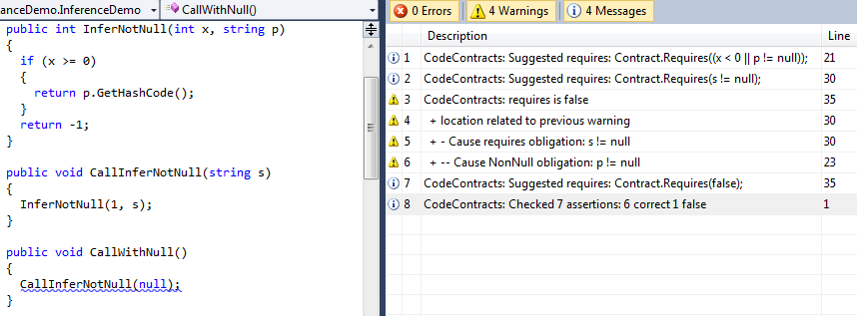
User experience

Slide 108
Experimental results
Un-annotated code (.net base libraries)
All paths analysis
Infer 18,643 preconditions
Simplification removes >32%
Conditional path analysis
Infers 28,623 preconditions
Simplification removes >24%
Similar results for partially annotated code (Facebook C# SDK)
Conditional path analysis is more precise but up to 4x slower than all-paths analysis
Because of inferred disjunctions

Slide 109
Postcondition Inference

Slide 110
Postcondition inference: theory
Have a method m
For each program point
Abstract state a
Approximate the concrete states at that point
Take the abstract state at the exit point of the method
public int HalfSum(int x, int y)
{
Contract.Requires(x >= 0);
Contract.Requires(y >= 0);
return x + (y - x) / 2;
}

Slide 111
In practice
Filter locals
Take into account inheritance rules
Remove redundant information
Ex. x >= 0, y == 0, x + y >= 0
Avoid suggesting existing precondition
…

Slide 112
Message prioritization

Slide 113
So we have a Top…
We should report it to the programmer
It can be:
a real bug?
a false positive?
In general impossible to tell
Undecidability of the analysis
Should sort all the messages
The one most likely to be bugs at the top

Slide 114
1. Warning partitioning
Partition warnings in classes
Contract violation
Non-null
Arrays
Overflows
…
Assign a fixed reward R to each class
R ∈ [ C → N ]
The highest the reward the more important

Slide 115
2. Scale rewards with outcome
False = 1.0 * R(c)
Important
Always wrong…
Bottom = 0.75 * R(c)
Unreached, we wanted it?
Top = 0.50 * R(c)
So many …
True = 0 * R(c)
Don’t care

Slide 116
3. Scale rewards with info
Proof obligation p contains
Variables from parameters
Variables result of a method call
…
The scale the reward
public foo(int z)
{
// ...
Contract.Assert(z + x > 0);
var f = Add();
Contract.Assert(f != null);
// ...
}

Slide 117
Caching

Slide 118
Caching?
At design time, few changes between two builds
Avoid re-analysis by caching
Algorithm
Construct the CFG for the method
Includes contracts explicit/inferred
Hash the CFG
If in the DB, just report the same output
Otherwise, re-analyze the method
Save it in the cache

Slide 119
Verified program repairs

Slide 120
The problem
Programs have bugs
Bug finders, static analyzers and verifiers, etc. help spot them
However, they provide little or no help for fixing the bugs
The goal
Bring static analyses to the next level
Report both the warning and the fix for it
While the programmer is authoring the program

Slide 121
Which bugs?
We focus on possible bugs reported by static analyzers/verifiers
Motto: “We can only fix what we can prove correct”
For instance, the CodeContracts static checker (Clousot) reports
Contract violations
Common runtime errors: Null pointers, division by zero, arithmetic overflows …
We should not only report the warning, but also a set of fixes for it
Increase adoption
Overcome the scaring long list of warnings
Help understanding the origin of the warning
Code is clearer than an error trace

Slide 122
What is a code repair?
In testing, use the test suite T as a specification
The buggy program fails at least one test in T
The repaired program succeeds all the tests in T
The repaired program is obtained by some mutation of the buggy program
This definition is unsuited for real-time program verification
It requires running the program
At design time, the program is incomplete, does not compile
Test running can be expensive
The repair is as good as the test suite T
Example: fix assert(e) with if(e) assert(e)

Slide 123
Verified code repairs
We propose a different yet semantic notion of repairs
A verified repair reduces the bad runs while increasing the good runs
A good run is one that satisfies the specification
Assertion, precondition, runtime condition …
A bad run is one that violates the specification
Consequences:
When we repair a program we cannot remove any good behavior
There can be multiple, non comparable, repairs
No best repair in general!

Slide 124
Example

Slide 125
From the .NET library
public void ValidateOwnerDrawRegions(ComboBox c, Rectangle updateRegionBox)
{
if (c == null)
{
var r = new Rectangle(0, 0, c.Width, c.Height);
// …
}
}

Slide 126
Repair #1: change the guard
public void ValidateOwnerDrawRegions(ComboBox c, Rectangle updateRegionBox)
{
if (c != null)
{
var r = new Rectangle(0, 0, c.Width, c.Height);
// …
}
}

Slide 127
Repair #2: Add precondition
public void ValidateOwnerDrawRegions(ComboBox c, Rectangle updateRegionBox)
{
Contract.Requires(c != null);
if (c == null)
{
var r = new Rectangle(0, 0, c.Width, c.Height);
// …
}
}

Slide 128
What if the code was like that?
public void ValidateOwnerDrawRegions(ComboBox c, Rectangle updateRegionBox)
{
if (c == null)
{
var r = new Rectangle(0, 0, c.Width, c.Height);
// …
}
else
{
var area = c.Width * c.Height;
// …
}
}

Slide 129
Changing the guard removes good runs
public void ValidateOwnerDrawRegions(ComboBox c, Rectangle updateRegionBox)
{
if (c != null)
{
var r = new Rectangle(0, 0, c.Width, c.Height);
// …
}
else
{
var area = c.Width * c.Height;
// …
}
}
This is not a
verified repair!

Slide 130
Adding a precondition removes bad runs
public void ValidateOwnerDrawRegions(ComboBox c, Rectangle updateRegionBox)
{
Contract.Requires(c != null);
if (c == null)
{
var r = new Rectangle(0, 0, c.Width, c.Height);
// …
}
else
{
var area = c.Width * c.Height;
// …
}
}
This is a
verified repair!

Slide 131
Formalization

Slide 132
Program analysis and Code repairs
There are three components in program analysis
The program text
The specification, the property to be specified
The analysis result, the semantic knowledge about the program execution
The (usual) verification problem is
“Check that the analysis result guarantees that the program meets its specification"
The (new) verified code repair problem is
“Refine the program using the analysis result so that it meets its specification”
Related, but different than program synthesis

Slide 133
Repairs are property-dependent
In static analysis tools, the knowledge is given by the inferred abstract state
Similar for tools based on model checking, deductive methods, types …
The abstract state belongs to some abstract domain
The abstract domain encodes some property of interest
Idea: An abstract domain should also know how to repair the program
Therefore the verified code repairs depend are property-dependent
E.g., often we cannot repair non-functional bugs like performance

Slide 134
Some definitions
A run is an execution trace, i.e., a sequence of concrete states
For all programs P, we partition the set of runs into
G(P), the good runs
B(P), the bad runs
We do not consider infinite traces here
Technically possible, complicates the exposition
A repair r is a program transformation with “some correctness condition”
Next: define the “correctness condition”

Slide 135
Verified repairs?
We may be tempted to define a verified repair as
G(P) ⊆ G(r(P)) and B(P)⊇ B(r(P))
But this definition is too strong!
It would work only for trivial repairs
Execution traces capture too much information
They are too fine grained, the repair may add new assertions
Solution? Perform abstractions!
The abstraction captures the behaviors we want to preserve and to correct
Intuition: Repair up to some observable property

Slide 136
Verified code repairs!
Idea: compare only the assertion runs of P and r(P)
Forget about intermediate states, keep only the states with the assertions
Define an abstraction function α_{V} in two steps
1. Remove all the states but those containing an assertion
2. Remove all assertions in r(P) but not in P
We want to compare only the “old” assertions
Definition: r is a verified code repair if
α_{V} (G(P)) ⊆ α_{V} (G(r(P))) and α_{V} (B(P)) ⊃ α_{V} (B(r(P)))

Slide 137
Consequences
Identity is not a repair
Runs of failing assertions should always decrease
For a given program there may be several distinct repairs r₁,r₂,r₃ …
The relation induces an order on programs
P ⊑ r₁(P) ⊑ r₁(r₂(P)) …
Repairs can be iterated to a fixpoint
In general there is no least fixpoint
No diamond property

Slide 138
Weak verified repairs
Further abstraction α_{W} to
Have sets of states instead of sets of traces
Forget the casual relationship between states
Have assertion truth instead of the particular values of the variables
Definition: r is a weak verified repair if
α_{W} ∘ α_{V} (G(P)) ⊆ α_{W} ∘ α_{V} (G(r(P))) and α_{W} ∘ α_{V} (B(P)) ⊃ α_{W} ∘ α_{V} (B(r(P)))
Intuition: a weak verified repair
Decreases the number of assertion violations without introducing regressions
Enables more repairs but with weaker guarantees in the concrete

Slide 139
Methodology
Design an abstract domain as usual
Abstract elements, domain operations, widening, transfer functions…
Design a code repair for the properties captured by the new abstract domain
Remember, code repairs are property-specific
Categorize your code repair:
Strong or weak verified repair?

Slide 140
In practice

Slide 141
Verified repairs from a static analyzer
Run the static analyzer to infer the abstract states
For each assertion in the program
Ask the abstract domains if they can prove it
If they cannot, ask the abstract domains to provide a code repair

Slide 142
Repairing floats
⊤
double f;
void SimpleError(double a, double b)
{
var tmp = a + b;
this.f = tmp;
if (this.f == tmp)
{ … }
}
f32
f64
fext
⊥
Clousot infers
this.f : f64
tmp : fext
Emits warning for precision mismatch
Suggests the verified repair:
tmp = (double)(a + b)

Slide 143
Repairing of overflows
int BinarySearch(int[] array, int value)
{
Contract.Requires(array != null);
int index, mid;
var inf = 0;
var sup = array.Length - 1;
while (inf <= sup)
{
index = (inf + sup) / 2;
mid = array[index];
if (value == mid) return index;
if (mid < value) inf = index + 1;
else sup = index - 1;
}
return -1;
}
Clousot infers the loop invariant
0 ≤ inf ≤ sup < array.Length ≤ 2³¹-1
We want to repair the arithmetic overflow
Suggest the verified repair:
inf + (sup – inf)/2
Guaranteed to not overflow
Because of the inferred loop invariant
Details in the paper

Slide 144
Verified repairs in Clousot
Contracts
Missing preconditions, postconditions, external assumptions, purity annotations
Constant and object initialization
Guards
Buffer overflows
Arithmetic overflows
Floating point comparisons
…
Details in the paper

Slide 145
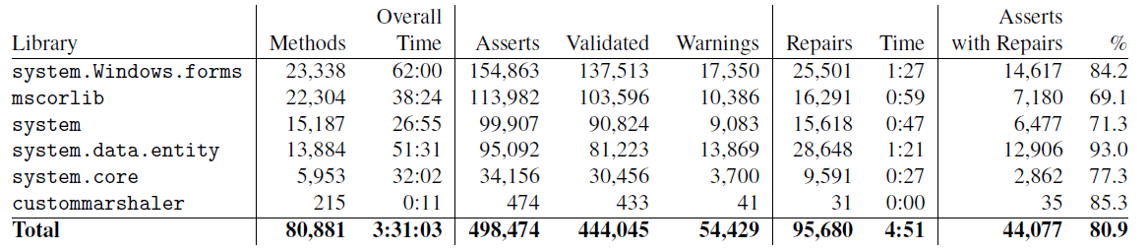
Raw numbers
Analyze .NET main libraries
Check Contracts, non-null, overflows …
Analyze 6+ methods/seconds
Infer 7.5 repairs/second

Slide 146
Precision
Verified
89%
Don’t know
11%
Verified repairs
9%
Warnings
2%

Slide 147
Conclusions…

Slide 148
CodeContracts
Specify code with code
No change to the build environment
Part of .NET v4
Documentation generation
Runtime checking
Static checking
Based on abstract interpretation
Predicatable, tunable, scalable, automatic!!!!
Try it today!!!!!

